Slide 1



Krshak Saathee
Team Members :
M. Harikesh 20071A6629
K. Santhosh Kumar 20071A6620
M. Sai Ritish Reddy 20071A6626
G. Hemanth Varma 20071A6613

Slide 2
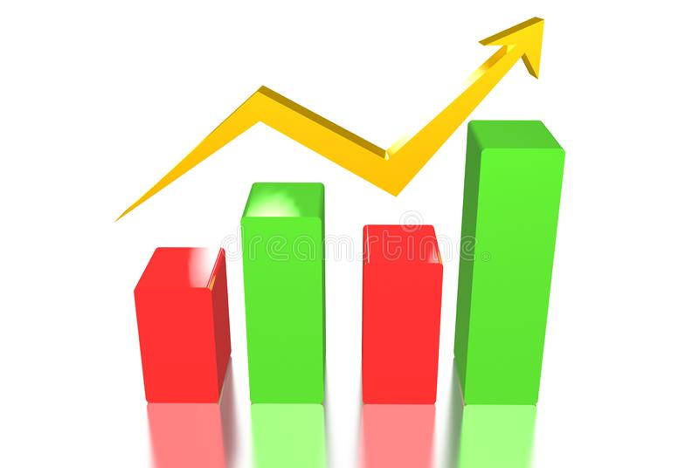
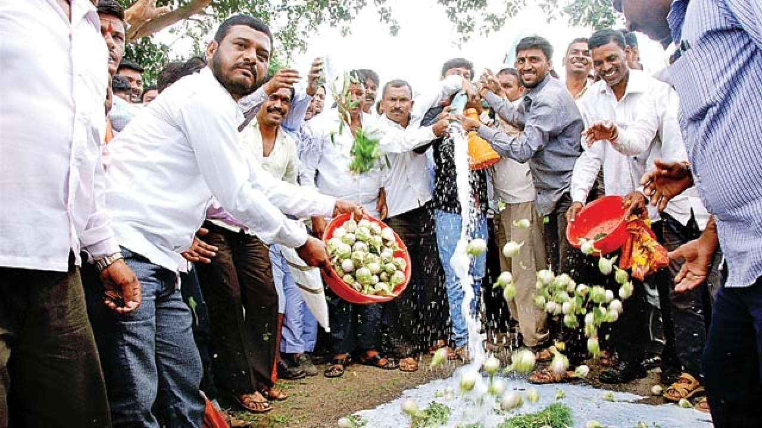
WHY?
Why are vegetable’s prices so unstable ?

Slide 3
Problem Statement
Making a one-stop web application for real-time yield statistics, crop and fertilizer recommendations.

Slide 4
Need Statement
In the past few decades, there has been a regular and common issue for the world wherein no farmer is able to get a fair price for his crop. Sometimes, the traditional agricultural practices can cause high production of the same crop variety, which leads to supply of the crop becoming higher than the demand. In case the above-described effect occurs in a particular crop year, majority of the farmers do not wish to cultivate the same crop in the future. This causes a severe shortage of the product and often leads to the sudden spike in their prices.
The root cause for these events is the agricultural communication imbalance, which has been occurring since many years and still persists.
In case, if it’s possible to predict the yield of a crop based on the previous trends, it will be extremely helpful to estimate the farmer’s profits.
So, we have chosen this problem statement to solve the two problems mentioned above, for a hope of a good progressive future of agriculture.

Slide 5
Stakeholders
Farmers
District Administration
Rythu Mandis

Slide 6
Our Solution :
We have implemented the solution in a web application, wherein the farmers can interact with the site to get statistical and textual information on various common queries and worries that they might have, such as :
Whether the crop they cultivate this season will be in demand and they can fetch a good price for it ?
What crop varieties are the farmers in their locality plan to grow, so that they can diversify their own crop to achieve secure price for it ?
How much yield can they get for their land size and further what price can they fetch for the yield for the crop season ?
Which crop is the most recommended for their soil composition and area ?
Which fertilizers do they need to give to the crops to maximize production according to their land’s soil profile ?

Slide 7
Technology and Methodologies Used
ML Models :
Linear Regression
Decision Tree
Technologies Used :
HTML 5
CSS
Bootstrap 5
Flask
Python Modules
scikit-learn
Numpy
Pandas
Matplotlib

Slide 8
Solution Processing
Web UI
Flask
Pickle file
ML Model
Dataset

Slide 9
Solution Implementation
Krshak Saathee
Current Statistics
Crop Registration
Crop Yield Statistics
Crop Recommendation
Fertilizer Recommendation

Slide 10
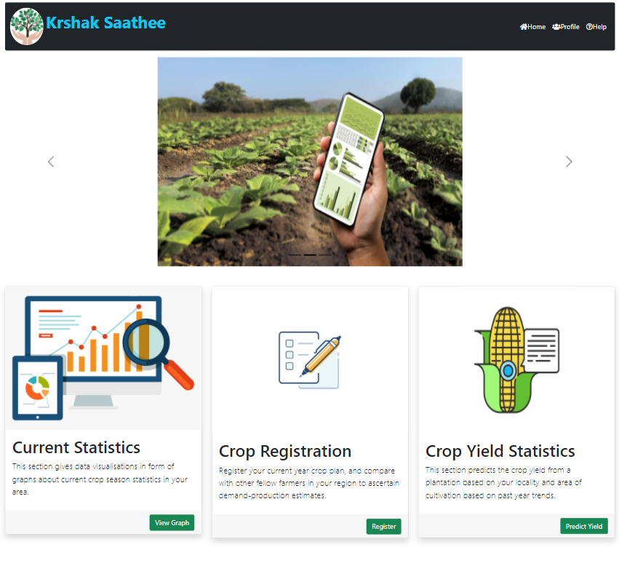
Krshak Saathee – Home Page

Slide 11
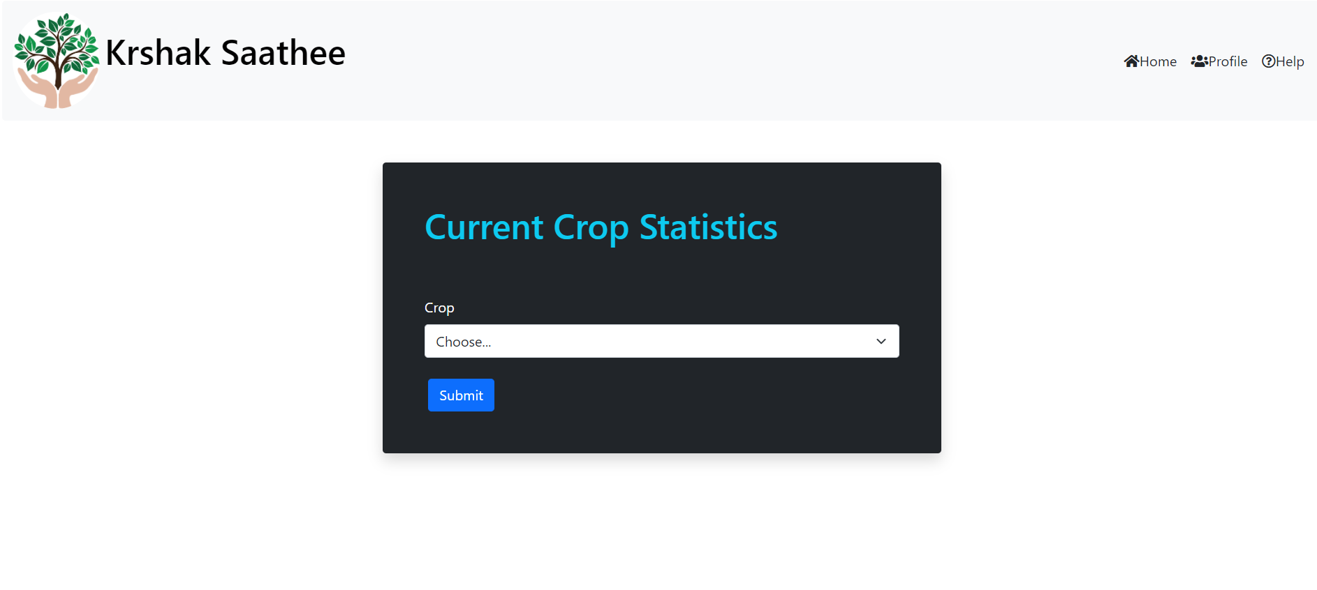
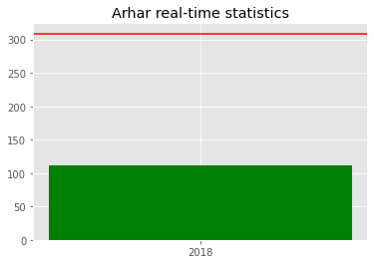
Current Crop Statistics
This part of the page redirects the user to the data visualization of the crop varieties planned to be cultivated in their area with the help of farmer surveys integrated to the page itself.

Slide 12
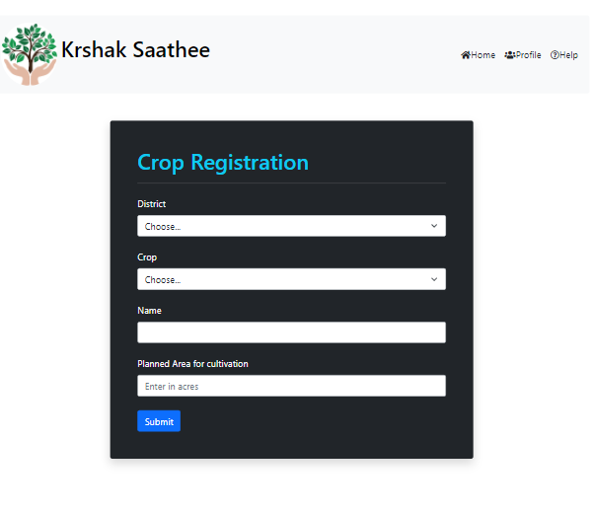
Crop Registration
Here, the farmers can register their planned crop varieties and the land area in which they plan to cultivate the crop, so that this data can be communicated through the crop statistics to help other farmers choose their crop variety wisely with estimates on demand and production estimates from the data received.

Slide 13
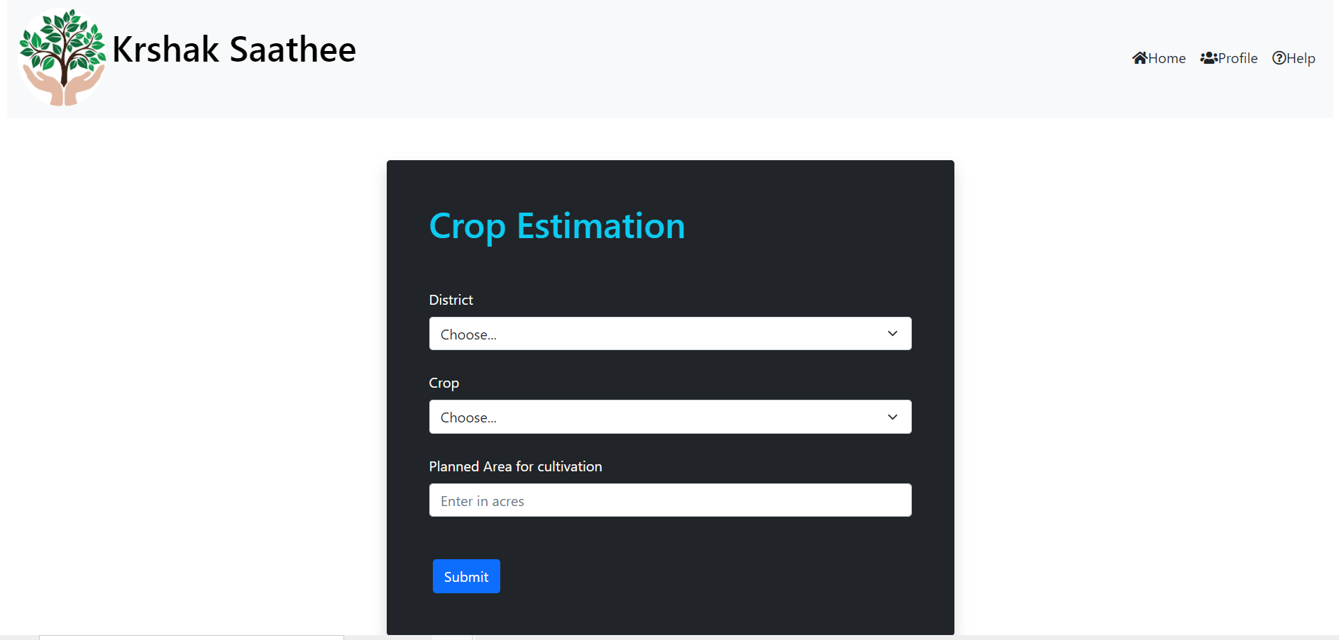
Crop Yield Statistics
Here, we provide the users with estimates on total production and total price they can get for the land size of cultivation for a crop variety in their district by prediction through Linear Regression Model with past years’ data.

Slide 14
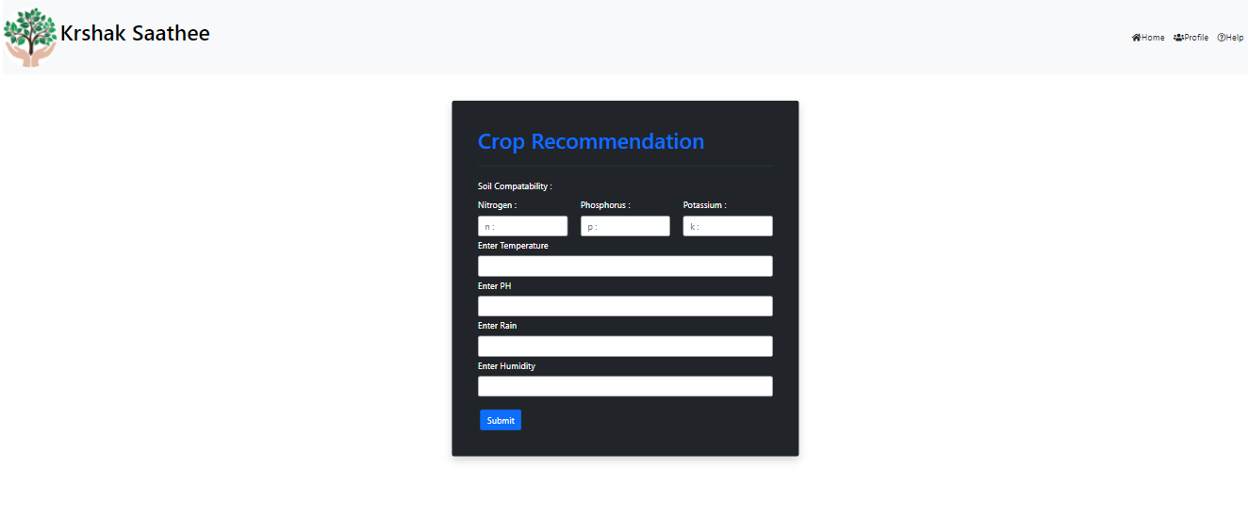
Crop Recommendation
Here, the user gets recommendation on crop variety suitable to the soil profile of their land.

Slide 15
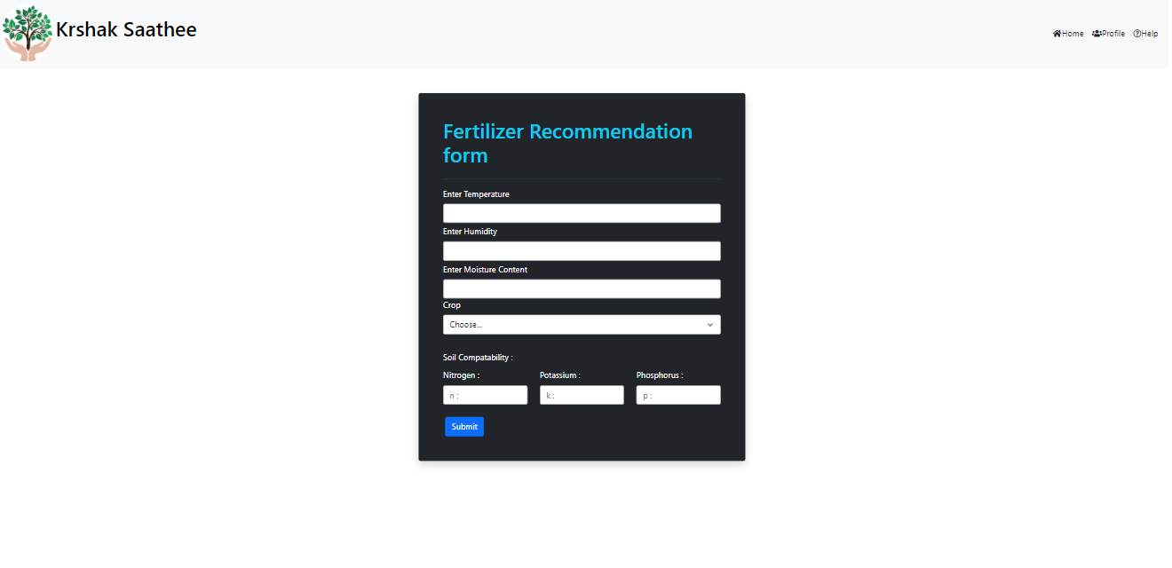
Fertilizer Recommendation
Here, the user gets recommendation on which fertilizers to apply on the crop to enhance production.

Slide 16
Accuracy Scores
Linear Regression Models :
 | Paddy | Sorghum | Arhar | Groundnut | Sesamum
Production | 93.92% | 82.86% | 60.07% | 77.05% | 65.02%
Price | 74.62% | 65.13% | 65.30% | 66.42% | 66.91%

Slide 17
Accuracy Scores
Decision Tree
 | Crop Recommendation | Fertilizer Recommendation
Accuracy | 96.63% | 94.73%

Slide 18
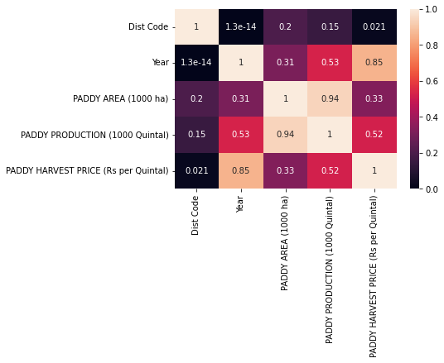
Regression Model on Paddy
Heatmap :

Slide 19
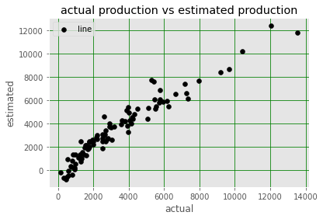
Regression Model on Paddy
Scatter Plot for production :

Slide 20
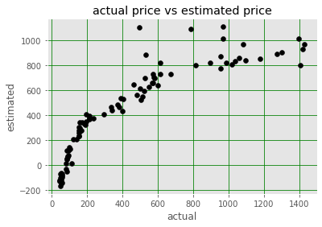
Regression Model on Paddy
Scatter Plot for price:

Slide 21
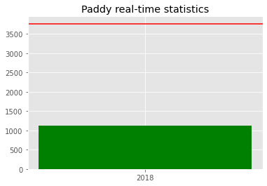
Regression Model on Paddy
Bar Plot for paddy :

Slide 22
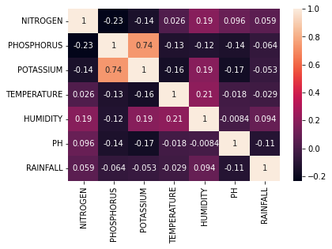
Decision Tree for Crop Recommendation
Heatmap :

Slide 23
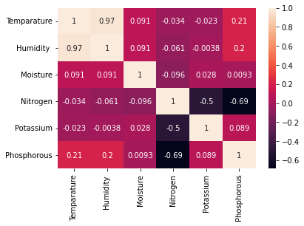
Decision Tree for Fertilizer Recommendation
Heatmap :

Slide 24
Future Scope
Developing a IoT-based application for easy collection of soil profiles periodically and integrating with ML models.
Enhancing the existing ML models with some social factors to increase accuracy

Slide 25
Resources
Data Source :
ICRISAT (http://data.icrisat.org/dld/src/crops.html)
Kaggle : Fertilizer, Crop recommendation dataset
https://www.kaggle.com/atharvaingle/crop-recommendation-dataset

Slide 26
Thank You

